Slide 1
External Sorting
Lecture 5 (CS1236)
Pranab Roy

Slide 3
Introduction
External sorting in data structures refers to a class of sorting algorithms designed to handle datasets that are too large to fit entirely within a computer's main memory (RAM).
These algorithms utilize external storage devices, such as hard drives or SSDs, to store and process portions of the data.
The main bottleneck for external sorting is minimizing the number of slow disk I/O operations, which are significantly slower than memory access.
External sorting is crucial for applications dealing with massive datasets,
such as database management systems, data warehousing, and large-scale data processing,
There efficient handling of data that exceeds memory capacity is paramount.

Slide 4
Methodology
External sorting typically uses a hybrid sort-merge strategy.
In the sorting phase, chunks of data small enough to fit in the main memory are read, sorted, and written out to a temporary file.
In the merge phase, the sorted sub-files are combined into a single larger file.
The external merge sort algorithm:
sorts chunks that each fit in RAM,
then merges the sorted chunks together.
We first divide the file into runs such that the size of a run is small enough to fit into the main memory.
Then sort each run in the main memory using the merge sort sorting algorithm.
Finally merge the resulting runs together into successively bigger runs, until the file is sorted.

Slide 5
Motivation
When We do External Sorting?
When the unsorted data is too large to perform sorting in computer internal memory then we use external sorting.
In external sorting we use the secondary device.
In a secondary storage device, we use the tape disk array.
when data is large like in merge sort and quick sort.
Quick Sort: best average runtime.
Merge Sort: Best Worse case time.
To perform sort-merge, join operation on data.
To perform order by the query.
To select duplicate element.
Where we need to take large input from the user.

Slide 6
Information Access from Disk
Before discussing external sorting techniques, consider again the basic model for accessing information from disk.
The file to be sorted is viewed by the programmer as a sequential series of fixed-size blocks.
Assume (for simplicity) that each block contains the same number of fixed-size data records.
Depending on the application, a record might be only a few bytes
—composed of little or nothing more than the key
—or might be hundreds of bytes with a relatively small key field.
Records are assumed not to cross block boundaries.
These assumptions can be relaxed for special-purpose sorting applications,
but ignoring such complications makes the principles clearer.
.

Slide 7
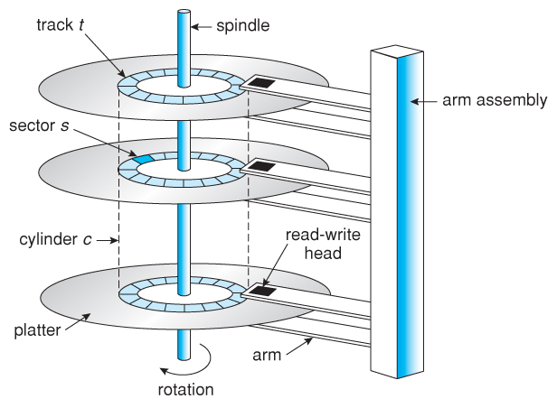
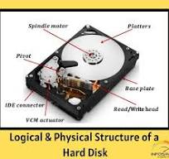
Information Access from Disk
A sector is the basic unit of I/O.
In other words, all disk reads and writes are for one or more complete sectors.
Sector sizes are typically a power of two, in the range 512 to 16K bytes, depending on the operating system and the size
and speed of the disk drive.
The block size used for external sorting algorithms should be equal to or a multiple of the sector size

Slide 8
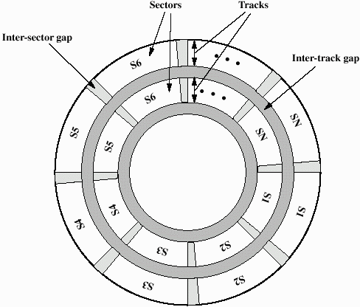
Data Organization and Formatting
The read/write heads are moveable along the radius of the disk.
This allows the heads to record information in multiple paths that form concentric circles on the disk.
Each one of these circles is called a track.
A typical hard drive disk contains thousands of these tracks, each being the width of the read/write heads.
In order to avoid possible interference between the tracks, a small gap is left between the tracks.
This gap is called the intertrack gap.
Reducing this gap allows for more data to be stored on a disk,
but it also increases the risk of having data corrupted when data from a neighboring track is written.
Each track is divided into fixed size blocks of information.
These blocks are called sectors.
Gaps are also left between the sectors.
These gaps allow for a physical separation between the blocks of data
and are typically used to help the hard drive controller
when reading from or writing to the disk. These gaps are called intersector gaps.

Slide 9
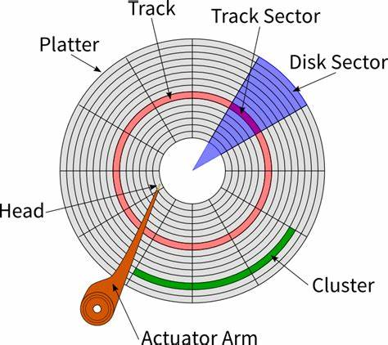
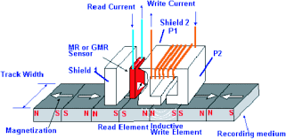
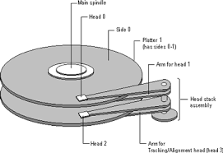
Information Access from Disk
Under this model, a sorting algorithm reads a block of data into a buffer in main memory,
performs some processing on it,
and at some future time writes it back to disk.
reading or writing a block from disk takes on the order of one million times longer than a memory access.
Based on this fact, we can reasonably expect that the records contained in a single block can be sorted by an internal sorting algorithm such as Quicksort in less time than is required to read or write the block.

Slide 10
Information Access from Disk
Under good conditions, reading from a file in sequential order is more efficient
than reading blocks in random order.
Given the significant impact of seek time on disk access, it might seem obvious that sequential processing is faster.
However, it is important to understand precisely under what circumstances sequential file processing is actually faster than random access,
because it affects our approach to designing an external sorting algorithm.

Slide 11
Information Access from Disk
Efficient sequential access relies on seek time being kept to a minimum.
The first requirement is that the blocks making up a file are in fact stored on disk in sequential order and close together,
preferably filling a small number of contiguous tracks.
Users typically do not have much control over the layout of their file on disk,
but writing a file all at once in sequential order to a disk drive with a high percentage of free space increases the likelihood of such an arrangement.

Slide 12
Information Access from Disk
The second requirement is that the disk drive’s I/O head remain positioned over the file throughout sequential processing.
This will not happen if there is competition of any kind for the I/O head.
For example, on a multi-user time-shared computer the sorting process might compete for the I/O head with the processes of other users.
Even when the sorting process has sole control of the I/O head, it is still likely that sequential processing will not be efficient.

Slide 13
Information Access from Disk
Imagine the situation where all processing is done on a single disk drive, with the typical arrangement of a single bank of read/write heads that move together over a stack of platters.
If the sorting process involves reading from an input file, alternated with writing to an output file, then the I/O head will continuously seek between the input file and the output file.
Similarly, if two input files are being processed simultaneously (such as during a merge process), then the I/O head will continuously seek between these two files.

Slide 14

The moral is that, with a single disk drive, there often is no such thing as efficient sequential processing of a data file.
Thus, a sorting algorithm might be more efficient
if it performs a smaller number of non-sequential disk operations rather than a larger number of logically sequential disk operations that require a large number of seeks in practice.

Slide 15
External Sort - Phases
External sorting typically involves two main phases:
The Sort Phase (or Distribution Pass):
The large dataset is read from the disk in smaller blocks that fit into the available main memory.
Each block is sorted internally using a fast, in-memory sorting algorithm like Quicksort or Merge Sort.
These sorted blocks, called "runs," are then written to temporary files on the disk.

Slide 16
External Sort - Phases
The Merge Phase:
The multiple sorted runs are then merged together.
This is often done using a multi-way merge process, which reads from several sorted runs simultaneously and combines them into a larger sorted run.
This merge process is repeated in several passes, with each pass producing larger and larger sorted runs, until a single, completely sorted file is created.

Slide 17
Merge Sort--A Digression
Merge sort is an ideal candidate for external sorting because it satisfies the two criteria for developing an external sorting algorithm.
Merge sort can be implemented either top-down or bottom-up.
The top-down strategy is typically used for internal sorting, whereas the bottom-up strategy is typically used for external sorting.
Top-Down Strategy
The top-down strategy works by:
Dividing the data in half
Sorting each half
Merging the two halves

Slide 18
Merge Sort--A Digression
Bottom-Up Strategy
The bottom-up strategy is the strategy that is used for external sorting.
The bottom-up strategy for merge sort works by:
Scanning through data performing 1-by-1 merges to get sorted lists of size 2.
Scanning through the size 2 sublists and perform 2-by-2 merges to get sorted lists of size 4.
Continuing the process of scanning through size n sublists
and performing n-by-n merges to get sorted lists of size 2n until the file is sorted
(i.e., 2n >= N, where N is the size of the file).

Slide 19
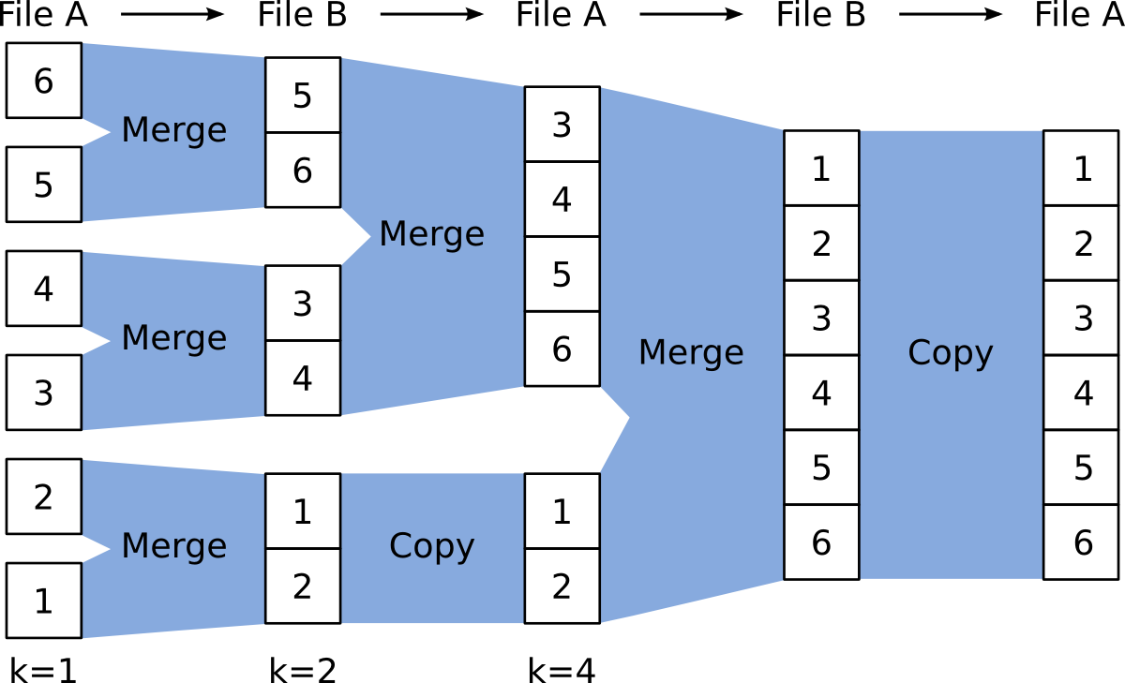

Slide 20
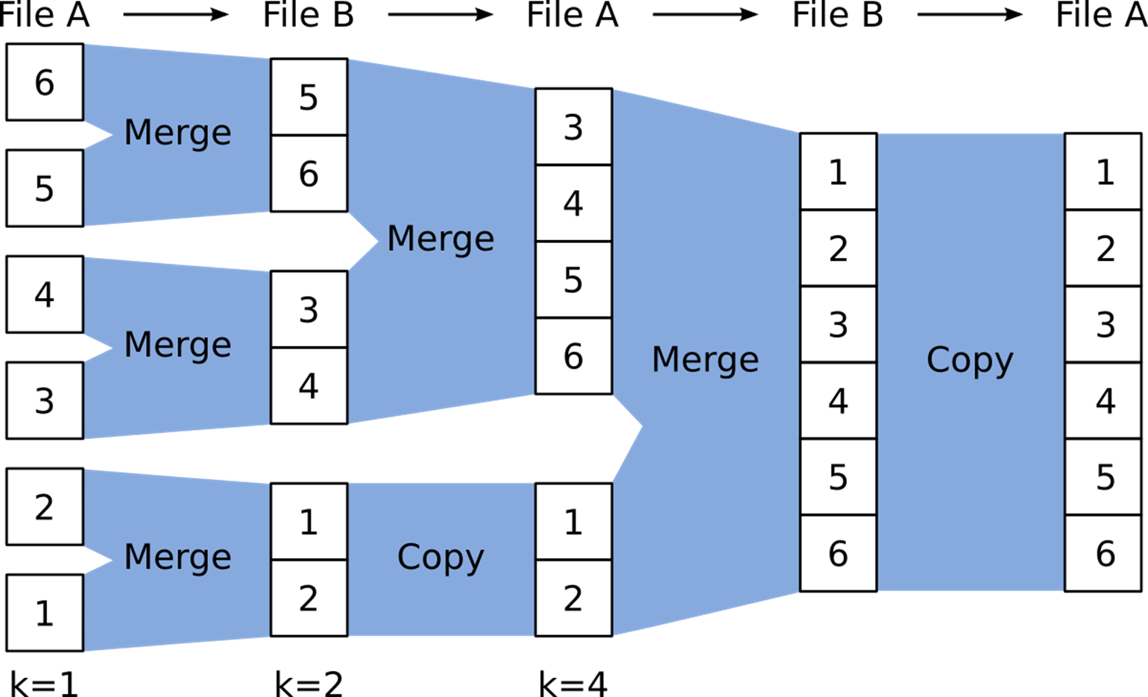
External Merge sort
Imagine dividing the integers stored in the input file into n sorted blocks, each of size k,
where k is initially equal to one and n is equal to the number of integers stored in the file.
On each pass through the file, data held in odd blocks can be merged with data held in even blocks to create n/2 blocks each of length 2k.
On each pass, data will need to be read from one file and written to the other.
For example, on the first pass, data in file A will be used as input, and the results of the merge will be written into file B;
on the second pass, data in file B will be used as input, and the results of the merge will be written into file A.
In this way, after log n passes, a sorted copy of the data will reside in either file A or file B.

Slide 21
Sorting using Tapes

Slide 22
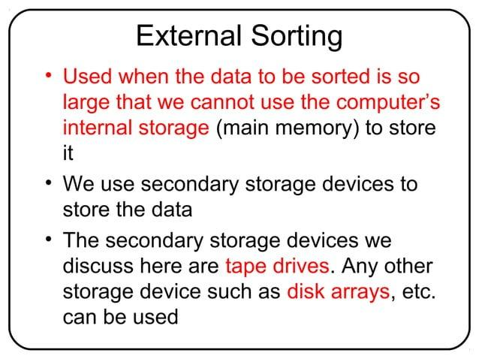

Slide 23
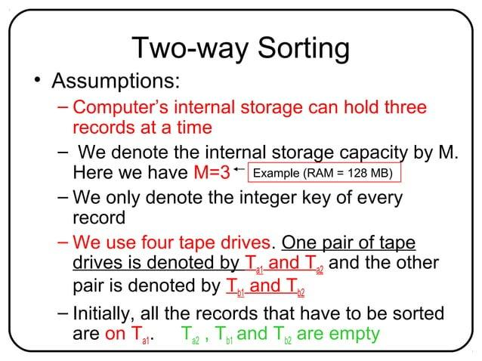

Slide 24
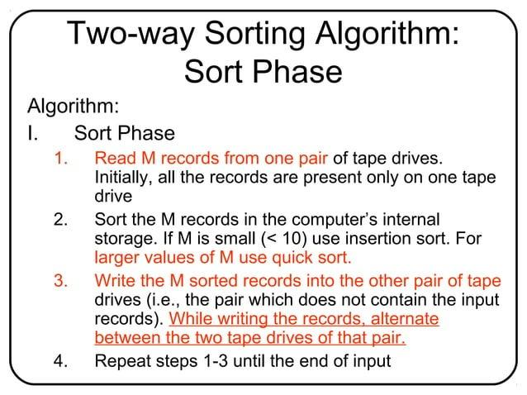

Slide 25
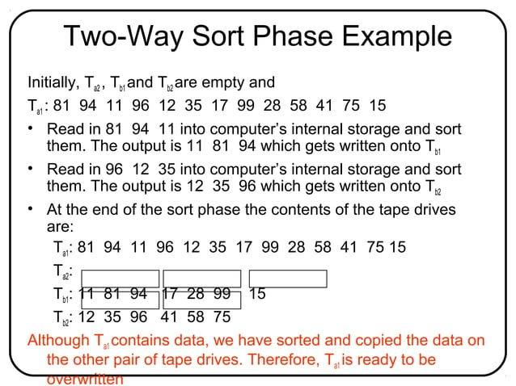

Slide 26
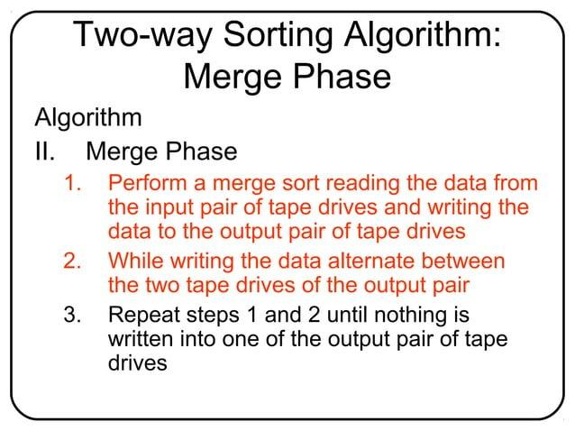

Slide 27
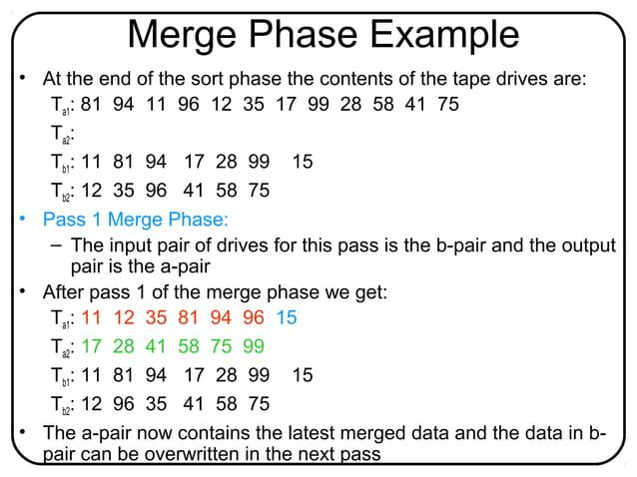

Slide 28
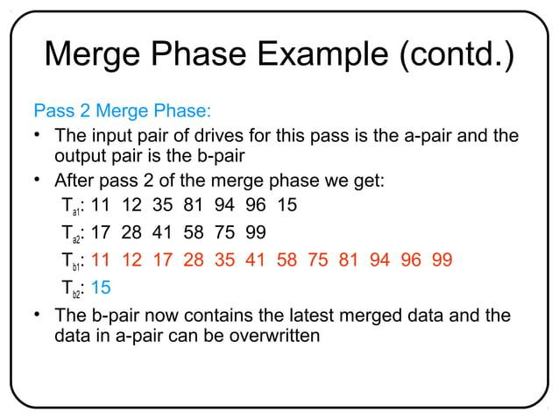

Slide 29
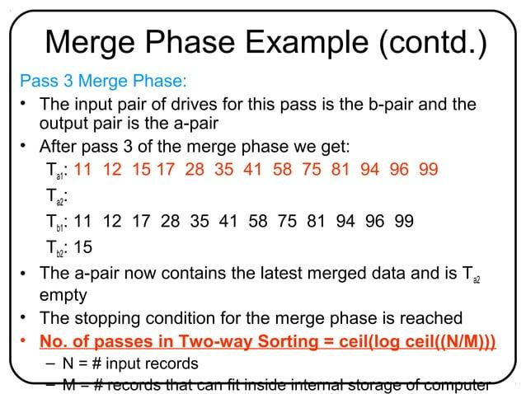

Slide 30
external sorting?
Problem: sort 1TB of data with 1GB of RAM.
  why not virtual memory?
    Swap involves expensive IOs

Slide 31
Using secondary storage effectively
General Wisdom :
  I/O costs dominate
  Design algorithms to reduce I/O

Slide 32
Streaming Data Through RAM
An important detail for sorting & other DB operations
Simple case:
  Compute f(x) for each record, write out the result
  Read a page from INPUT to Input Buffer
  Write f(x) for each item to Output Buffer
  When Input Buffer is consumed, read another page
  When Output Buffer fills, write it to OUTPUT
Reads and Writes are not coordinated
  E.g., if f() is Compress(), you read many pages per write.
  E.g., if f() is DeCompress(), you write many pages per read.
Input
Buffer
Output
Buffer
INPUT
f(x)
OUTPUT
RAM

Slide 33
2-Way Sort
Pass 0: Read a page, sort it, write it.
  only one buffer page is used (as in previous slide)
Pass 1, 2, …, etc.:
  requires 3 buffer pages
  merge pairs of runs into runs twice as long
  three buffer pages used.
INPUT 1
OUTPUT
INPUT 2
Main memory buffers
Disk
Disk

Slide 34






Two-Way External Merge Sort
3,4 6,2 9,4 8,7 5,6 3,1
2
Input file
PASS 0
1-page runs
PASS 1
Idea: Divide and conquer: sort sub- files and merge into larger sorts
3,4 2,6 4,9 7,8 5,6
1,3 2
2,3
4,7
1,3
2-page runs
4,6
8,9
5,6
2
PASS 2
2,3
4,4
6,7
8,9
1,2
3,5
6
4-page runs
N is the number of records
B is the number of records per page
M is the size of main memory in number of records
PASS 3
1,2
2,3
3,4
4,5
6,6
7,8
9
8-page runs

Slide 35
Two-Way External Merge Sort
3,4 6,2 9,4 8,7
3,4 2,6 4,9 7,8 5,6
5,6 3,1
2
Input file
PASS 0
1-page runs
PASS 1
Costs for pass : all pages
1,3 2
2,3
4,7
1,3
2-page runs
4,6
8,9
5,6
2
# of passes : height of tree
PASS 2
2,3
4,4
6,7
8,9
1,2
3,5
6
4-page runs
Total cost : product of above
PASS 3
1,2
2,3
3,4
4,5
6,6
7,8
9
8-page runs

Slide 36
Two-Way External Merge Sort
Each pass we read + write each page in file.
N pages in the file => the number of passes
So total cost is:
Idea: Divide and conquer: sort subfiles and merge
3,4
6,2
9,4
8,7
5,6
3,1
2
Input file
PASS 0
3,4
2,6
4,9
7,8
5,6
1,3
2
1-page runs
PASS 1
2,3
4,7
1,3
2-page runs
4,6
8,9
5,6
2
PASS 2
2,3
4,4
1,2
4-page runs
6,7
3,5
8,9
6
PASS 3
1,2
2,3
3,4
8-page runs
4,5
6,6
7,8
9

Slide 37

Two-Way External Merge Sort
Each pass we read + write each page in file.
N/B pages in file => 2N/B
Input file
PASS 0
page runs
PASS 1
page runs
3,4
6,2
9,4 8,7 5,6 3,1
2
3,4 2,6 4,9 7,8 5,6
1,3 2
2,3
4,7
1,3
Number of passes
4,6
8,9
5,6
2
PASS 2
2,3
4,4
6,7
8,9
1,2
3,5
6
= ⎡log ^{N ⎤} +1
⎢
4-page runs
2
B ⎥
PASS 3
1,2
2,3
3,4
4,5
6,6
7,8
9
So total cost is:
N ⎛ ⎡ N ⎤ ⎞
B ⎥
8-page runs
2
⎜ log
+1⎟
_{B} ⎜ ⎢
2
⎟
⎝
⎠

Slide 38
Cost of External Merge Sort
Number of passes:
Cost = 2N/B * (# of passes)
=1+ ⎡log_{M / B−1} ⎡N / M ⎤⎤

Slide 39
General External Merge Sort
More than 3 buffer pages. How can we utilize them?
To sort a file with N pages using B buffer pages:
  Pass 0: use B buffer pages. Produce sorted runs of B pages each.
  Pass 1, 2, …, etc.: merge B-1 runs.
INPUT 1
. . .
INPUT 2
. . .
. . .
OUTPUT
INPUT B-1
Disk
Disk
B Main memory buffers

Slide 40
Cost of External Merge Sort
Number of passes:
Cost = 2N * (# of passes)
E.g., with 5 buffer pages, to sort 108 page file:
  Pass 0: = 22 sorted runs of 5 pages each (last run is only 3 pages)
Now, do four-way (B-1) merges
  Pass 1: = 6 sorted runs of 20 pages each (last run is only 8 pages)
  Pass 2: 2 sorted runs, 80 pages and 28 pages
  Pass 3: Sorted file of 108 pages

Slide 41
Number of Passes of External Sort
( I/O cost is 2N times number of passes)

Slide 42
External Merge Sort
What if we had more buffer pages?
How do we utilize them wisely ?

Slide 43
Phase 1 : Prepare
INPUT 1
. . .
INPUT 2
. . .
NPUT M/B
I
Disk
Disk
M/B Main memory buffers
Construct as large as possible starter lists.

Slide 44
Phase 2 : Merge
INPUT 1
. . .
INPUT 2
. . .
OUTPUT
INPUT M/B-1
Disk
M/B Main memory buffers
Disk
Compose as many sorted sublists into one long sorted list.

Slide 45
General External Merge Sort
🖛 How can we utilize more than 3 buffer pages?
To sort a file with N/B pages using M/B buffer pages:
– Pass 0: use M/B buffer pages. Produce ^{⎡ N} / ^{M ⎤} sorted runs of M/B pages each.
⎢ B B ⎥
– Pass 1, 2, …, etc.: merge M/B-1 runs.
INPUT 1
. . .
INPUT 2
. . .
. . .
OUTPUT
INPUT M/B-1
Disk
Disk
M/B Main memory buffers

Slide 46
Example
Buffer : with 5 buffer pages
File to sort : 108 pages
  Pass 0:
    Size of each run?
    Number of runs?
  Pass 1:
    Size of each run?
    Number of runs?
  Pass 2: ???

Slide 47
Example
Buffer : with 5 buffer pages
File to sort : 108 pages
  Pass 0: ⎡108 / 5⎤ = 22 sorted runs of 5 pages each (last run is only 3 pages)
  Pass 1: ⎡22 / 4⎤= 6 sorted runs of 20 pages each (last run is only 8 pages)
  Pass 2: 2 sorted runs, 80 pages and 28 pages
  Pass 3: Sorted file of 108 pages
    Total I/O costs: ?

Slide 48
Example
Buffer : with 5 buffer pages
File to sort : 108 pages
  Pass 0: ⎡108 / 5⎤ = 22 sorted runs of 5 pages each (last run is only 3 pages)
  Pass 1: ⎡22 / 4⎤= 6 sorted runs of 20 pages each (last run is only 8 pages)
  Pass 2: 2 sorted runs, 80 pages and 28 pages
  Pass 3: Sorted file of 108 pages
Total I/O costs:
2*108 * (4 passes)

Slide 49
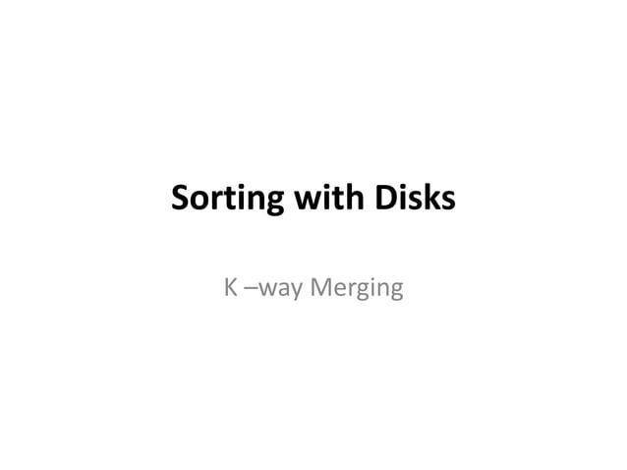

Slide 50
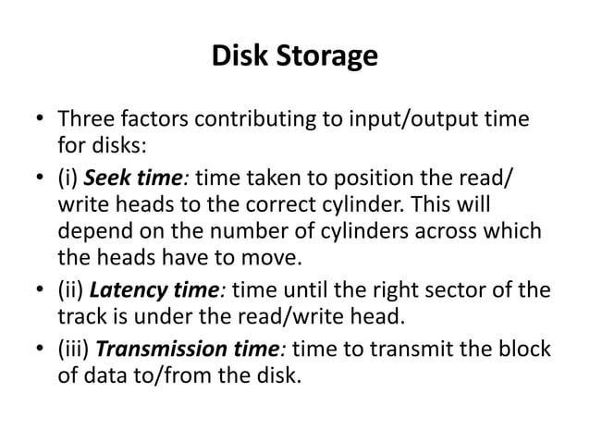

Slide 51
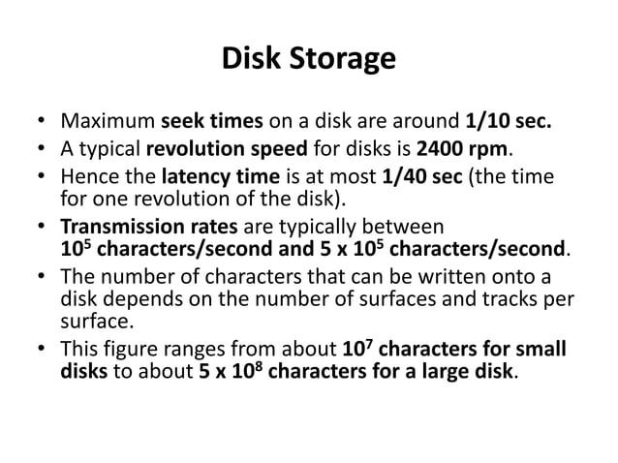

Slide 52
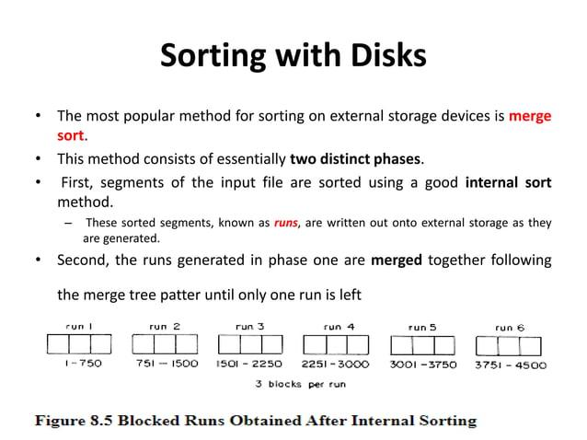

Slide 53
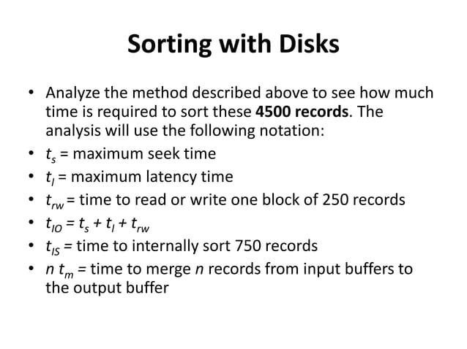

Slide 54
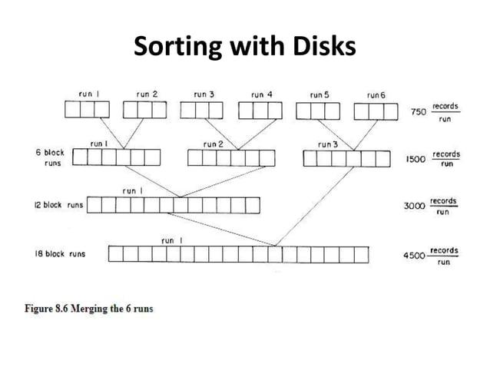

Slide 55
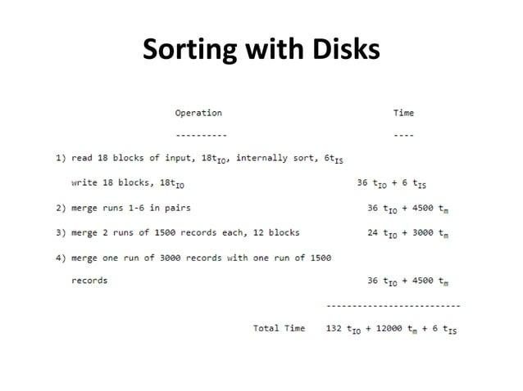

Slide 56
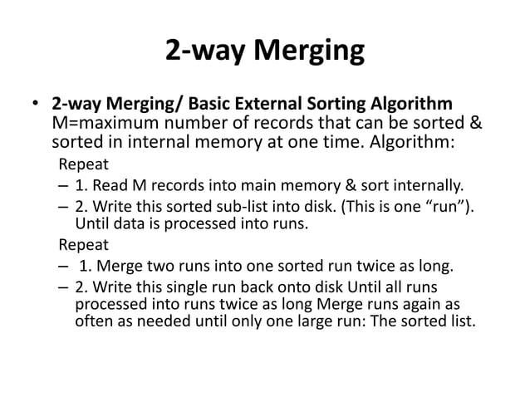

Slide 57
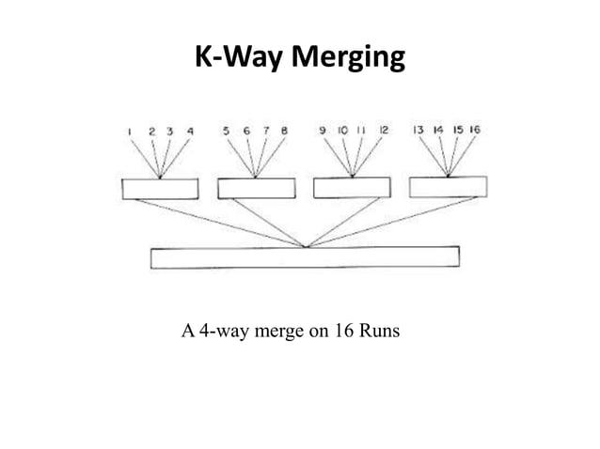

Slide 58
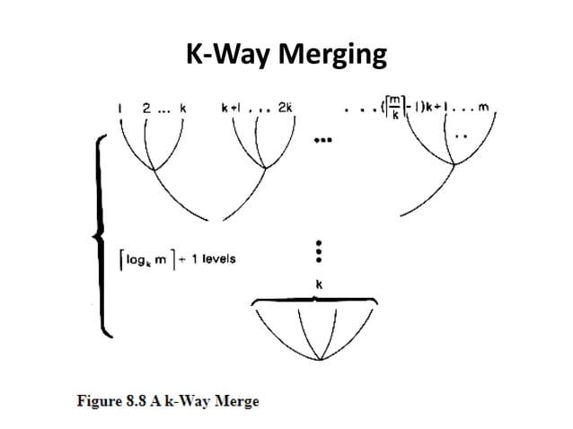

Slide 59
Sorting Records!
Sorting has become a blood sport!
  Parallel sorting is the name of the game ...
Minute Sort: how many 100-byte records can you sort in a minute?
  Typical DBMS: 10MB (~100,000 records)
  Current World record: 21.8 GB
    64 dual-processor Pentium-III PCs (1999)
Penny Sort: how many can you sort for a penny?
  Current world record: 12GB
    1380 seconds on a $672 Linux/Intel system (2001)
    $672 spread over 3 years = 1404 seconds/penny
See http://research.microsoft.com/barc/SortBenchmark/

Slide 60
Conclusion
External sorting is important; DBMS may dedicate part of buffer pool for sorting!
External merge sort minimizes disk I/O cost:
  Pass 0: Produces sorted runs of size B (# buffer pages). Later passes: merge runs.
  # of runs merged at a time depends on B, and block size.
  Larger block size means less I/O cost per page.
  Larger block size means smaller # runs merged.
  In practice, # of passes rarely more than 2 or 3.

Slide 61
Conclusion
Choice of internal sort algorithm may matter:
  Quicksort: Quick!
  Heap/tournament sort: slower (2x), longer runs
The best sorts are wildly fast:
  Despite 40+ years of research, we’re still improving!
Clustered B+ tree is good for sorting; unclustered tree is usually very bad.

Slide 62
Thank You

